Slide 1
Reading Latin America welcoming award-winning children’s literature into your classrooms.
Luciano Marzulli
K-16 Outreach Coordinator

Slide 2
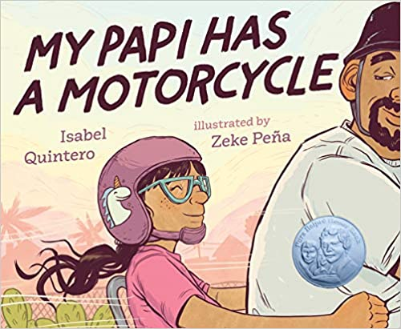
This session will provide an opportunity to take an in depth look at the 2020 Américas Award Honorable Mention title: My Papi has a Motorcycle written by Isabel Quintero and illustrated by Zeke Peña.
Notes:
My intro-who am I and what do I do
Who is in the room?
Poll in zoom:
Anyone here currently own a motorcycle?

Slide 3
Américas Award
CLASP founded the Américas Award in 1993 to encourage and commend authors, illustrators and publishers who produce quality children’s and young adult books that portray Latin America, the Caribbean, or Latinx in the United States, and to provide teachers with recommendations for classroom use. CLASP offers up to two annual book awards, together with a commended list of titles.

Slide 4
My Papi Has a Motorcycle
Award-winning author and illustrator team Isabel Quintero and Zeke Peña bring a story of childhood memories to life in My Papi has a Motorcycle. Daisy Ramona waits for her dad to come home from work to go on a ride around town on the back of his motorcycle. Everything Daisy sees is familiar to her. The route, the locales, and the people all come together to tell the story of a lively immigrant community. As Daisy observes changes in her neighborhood, she takes comfort in knowing some things will never change, such as the quality time spent with her papi and the love they share. Quintero takes inspiration straight from her memories, growing up in Corona, CA and going on motorcycle rides with her dad. Peña’s comics-inspired illustrations and sunset tones bring a magical feel to this golden hour tale. Together, Quintero and Peña create a mesmerizing picture book that wonderfully captures details of a happy childhood and the love between a father and his daughter.
Notes:
Award-winning author and illustrator team Isabel Quintero and Zeke Peña bring a story of childhood memories to life in My Papi has a Motorcycle. Daisy Ramona waits for her dad to come home from work to go on a ride around town on the back of his motorcycle. Everything Daisy sees is familiar to her. The route, the locales, and the people all come together to tell the story of a lively immigrant community. As Daisy observes changes in her neighborhood, she takes comfort in knowing some things will never change, such as the quality time spent with her papi and the love they share. Quintero takes inspiration straight from her memories, growing up in Corona, CA and going on motorcycle rides with her dad. Peña’s comics-inspired illustrations and sunset tones bring a magical feel to this golden hour tale. Together, Quintero and Peña create a mesmerizing picture book that wonderfully captures details of a happy childhood and the love between a father and his daughter.

Slide 5
Isabel Quintero
Isabel Quintero is a renowned writer from Southern California. She is the daughter of Mexican immigrants. In addition to Gabi, Fragments of a Teenager, Quintero has written a series of books for young readers titled Ugly Cat and Pablo (Scholastic, Inc.), a graphic biography, Photographic: The Life of Graciela Iturbide (Getty Publications, 2018), the which received the Boston Globe Horn Book Award, and the illustrated children's book My Papi Has a Motorcycle (Kokila, 2019). Isabel also writes poetry and essays. You can find some of her texts in The Normal School, Huizache, The Acentos Review, As / Us Journal, The James Franco Review, and other publications.
https://laisabelquintero.com/about/

Slide 6
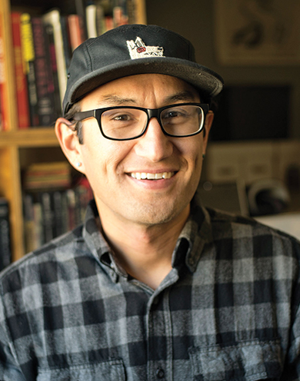
Zeke Peña
Zeke Peña makes comics and illustrations as an accessible way to reclaim stories and remix history. He was born in Las Cruces, NM and grew up in El Paso, TX. He has a degree in Art History from the University of Texas at Austin and is self-taught in drawing and painting. He received the 2020 Ezra Jack Keats and Pura Belpré Illustrator Honor Awards for his first children’s book My Papi Has a Motorcycle, written by Isabel Quintero and published by Kokila/Penguin Young Readers. He also received the 2018 Boston Globe Horn Book Award for Photographic: The Life of Graciela Iturbide (Getty Publishing, 2017), a graphic biography he illustrated. He has published work with REMEZCLA, VICE.com, Latino USA, The Believer Magazine, The Nib, Penguin Random House, Algonquin Books, Holt/Macmillan and Cinco Puntos Press. Zeke is currently digging into family history to uncover stories for future books.
zpvisual.com

Slide 7
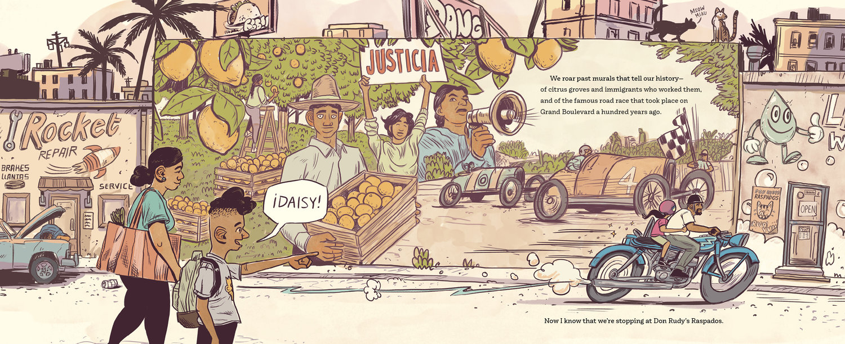
Let’s Read!
Storytime with Librarian Meli-
https://www.youtube.com/watch?v=P6FIEmjBNNk

Slide 8
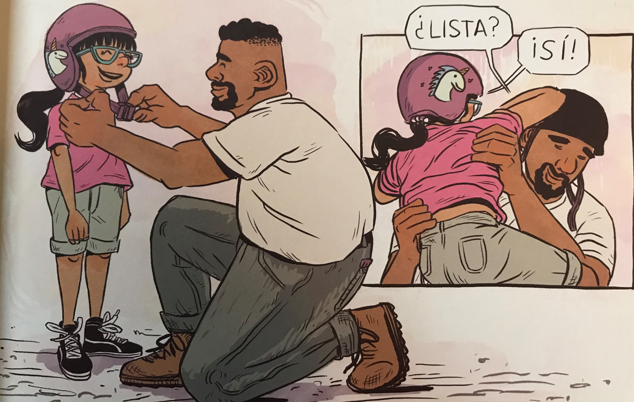
Language Use in My Papi Has A MotorCycle
While this book is published in English the narrative employs Spanish language throughout in speech, descriptions and background scenery.
Daisy’s bilingual ability is a given. This is an opportunity to explore the assets of multiple language ability among your students. Who can define the words in Spanish? How would the narrative change if there was no Spanish language used throughout?

Slide 9
Corona California
Quintero shares some of the history of the books setting, Corona California.
What else can you explore about Corona California or other citrus grove cities?
https://www.coronaca.gov/about-us

Slide 10
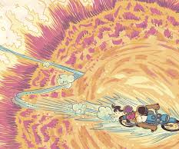
Additional Readings & resource links…
Link to publisher: https://www.penguinrandomhouse.com/books/588648/my-papi-has-a-motorcycle-by-isabel-quintero-illustrated-by-zeke-pena/
Articles on gentrification:
https://www.nationalgeographic.org/encyclopedia/gentrification/
https://www.washingtonpost.com/outlook/2019/09/13/how-gentrification-caused-americas-cities-burn/
Corona California:
https://www.coronaca.gov/about-us

Slide 11
Américas award resources
CLASP website
http://claspprograms.org/pages/detail/86/Americas-Award-

Slide 12
READ U
Curated book sets through the College of Education:
http://readu.utah.edu

Slide 13
Let’s work together!
Luciano Marzulli
l.marzulli@utah.edu
K-16 Outreach Coordinator
Center for Latin American Studies
801.581.6518
http://ias.utah.edu

